Slide 1
Database Design and Implementation
Group 7
Course Instructor: Dr. NKEMENI Valery

Slide 2
OUTLINE
Conceptual Design
Constraints and Validation Rules
Logical Design and Schema Creation
Implementation and Testing
Physical Design

Slide 3
1
Requirement Analysis and Conceptual Design
An overview of requirements and high-level conceptual model

Slide 4
Key Entities and Attributes
Users:
Emergency Services:
userId, name, contactInfo
serviceId, type, contactInfo
Incidents:
Government Agencies:
incidentId, location, type, description, timestamp
agencyId, name, directives
Volunteer:
Weather Data Providers:
volunteerId, skills, availability,badges
providerId, weatherData

Slide 5
2
Logical Design & Schema Creation
An overview of logic database design

Slide 6
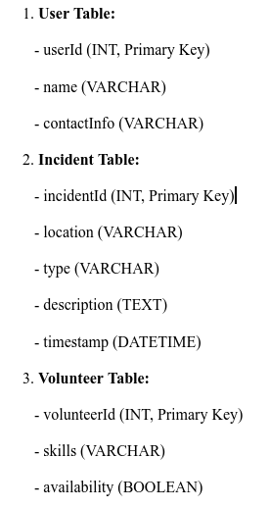
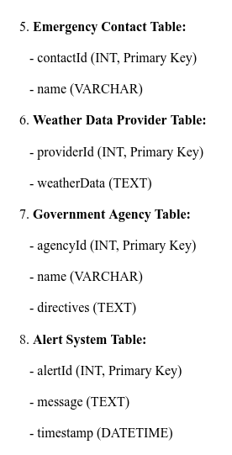
Each entity is transformed into a table, and each attribute into columns with specified data types

Slide 7
Normalization & Denormalization
Normalization
Denormalization
It is done to ensure there is no unnecessary duplicate information and that the data is accurate and includes 1NF, 2NF and 3NF
It is employed to make a database work faster by simplifying how data is retrieved

Slide 8
Considerations for Optimization & Scalability
01
02
Indexing
Partitioning
Large tables are split into sections based on common attributes.
Quick references are created for parts looked up often.
03
04
Concurrency & Locking
Caching
Strategies are devised to allow many users to update or delete data simultaneously without issues.
Information used frequently but seldom changed is kept readily accessible.

Slide 9
3
Physical Design and Indexing
The adjustment of the physical attributes of the model based on the logical model in order to optimize the database performance.

Slide 10
PostgreSQL
Open Source
Free to use, distribute, and modify.
Cost-Effective
Significant savings compared to commercial databases.
Rich Data Types
Supports arrays, JSON, hstore, and more.
Scalability
Handles large volumes of data and high-concurrency environments.

Slide 11
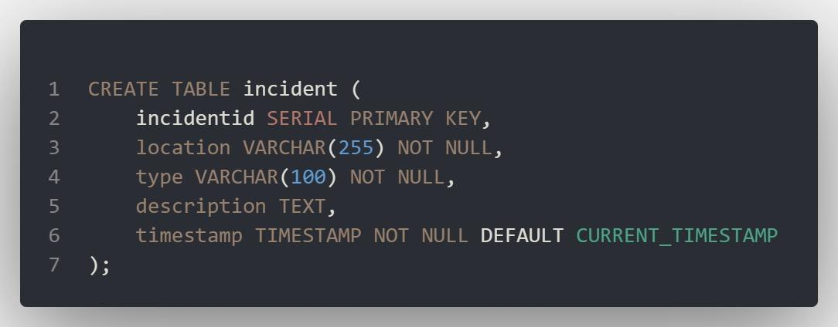
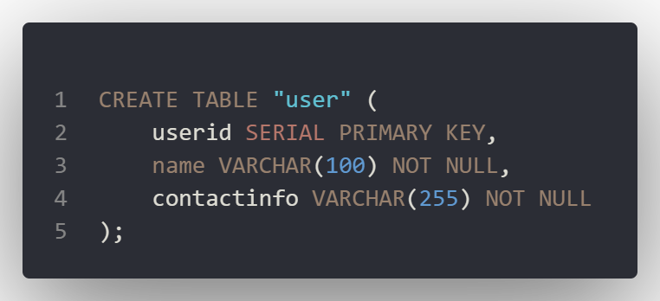
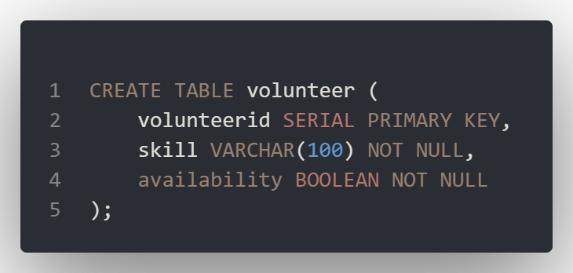
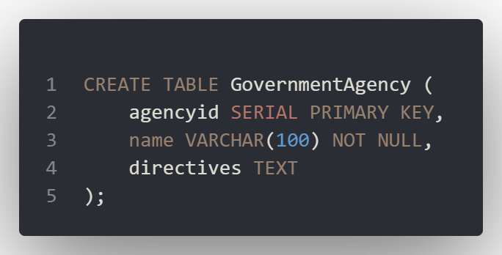
Creating the Database Tables

Slide 12
4
Constraints and Validation Rules

Slide 13
CONSTRAINTS
Rules that enforce limits and conditions on the data that can be inserted or updated in a table
VALIDATION
The process ensuring that data entered into a system is accurate, meaningful, and meets the required business rules and constraints

Slide 14
CONSTRAINTS
Primary Key
Foreign Key
Unique
Not Null
Uniquely identifies records
Establish links between two tables
Ensures values in a column are distinct
Column can not contain null

Slide 15
VALIDATION
Data
Format
Range
Ensure data is of the correct type
Checking that data adheres to a specified format
Verifying that numeric data falls

Slide 16
Referential Integrity
Business Rule enforcement
Data consistency
Error Handling
Performance Consideration
Overall System Constraints and Validation

Slide 17
5
Implementation and Testing

Slide 18
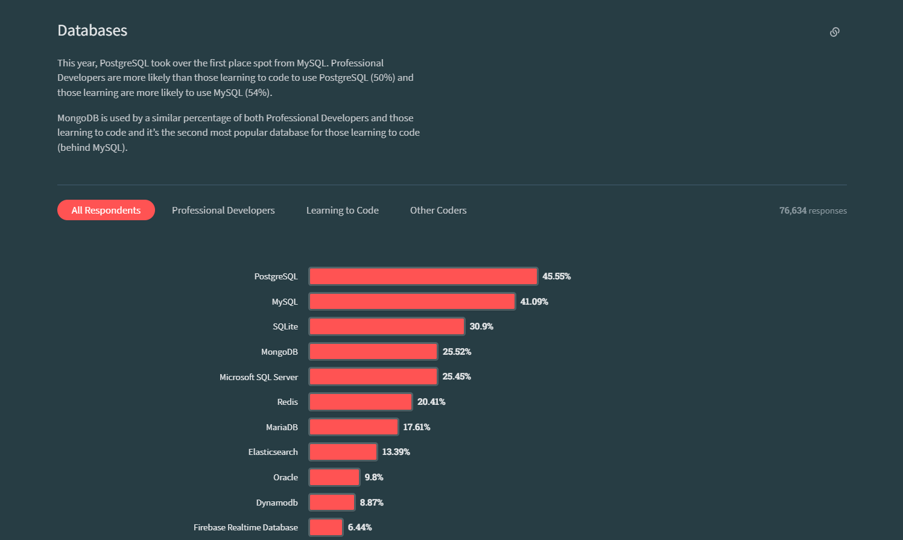

Slide 19




PostgreSQL
Extensible Architecture
Advanced PostGIS
Complaint with Cloud databases like Superbase and Firebase.
To work with Geographic objects.
Open Source
Scalability
Cost-effective and benefits from a large community of developers
Store a high volume of data
Automatic ERD generation
Reliable to Real-time weather updates
Provides statistics on performance and queries

Slide 20
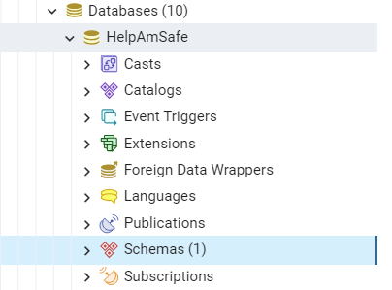
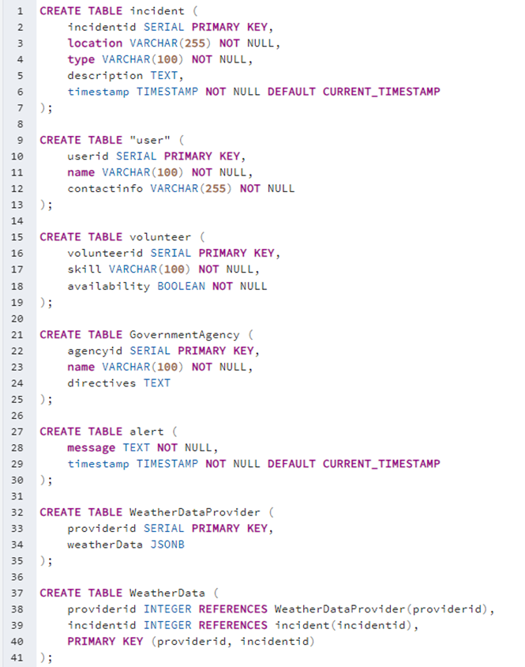
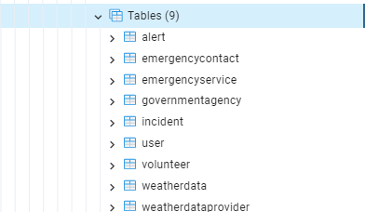

Slide 21
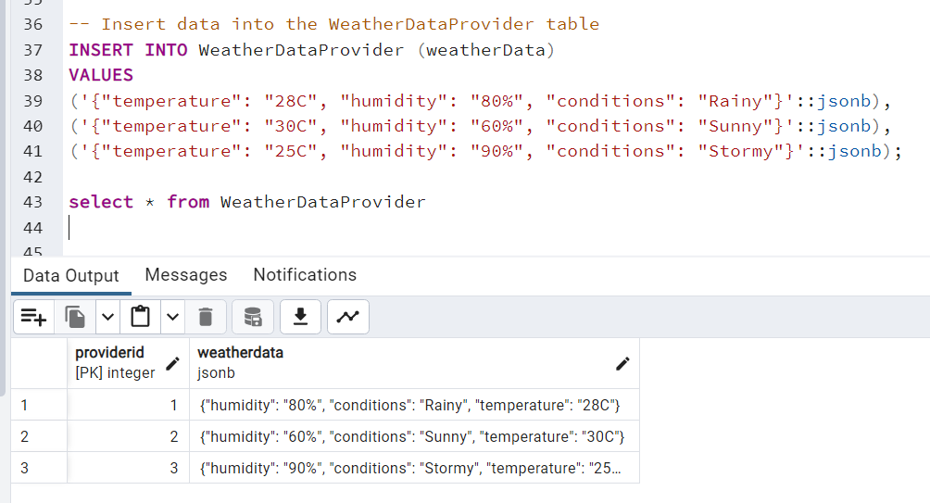

Slide 22
Conclusion
Our disaster management system, powered by PostgreSQL, offers a robust, scalable, and secure database solution. PostgreSQL's ACID compliance, GIS support, and advanced performance features ensure efficient handling and analysis of critical data. This well-designed database structure supports real-time data processing and integration, making it a reliable backbone for effective disaster response and recovery operations.

